Slide 1
Advanced Python Programming for Emerging Applications

Slide 2
COURSE OBJECTIVES
To develop skills in file handling and exception handling.
To build applications for automating tasks.
To build web scraping applications.
To create applications for data analysis and visualization.

Slide 3
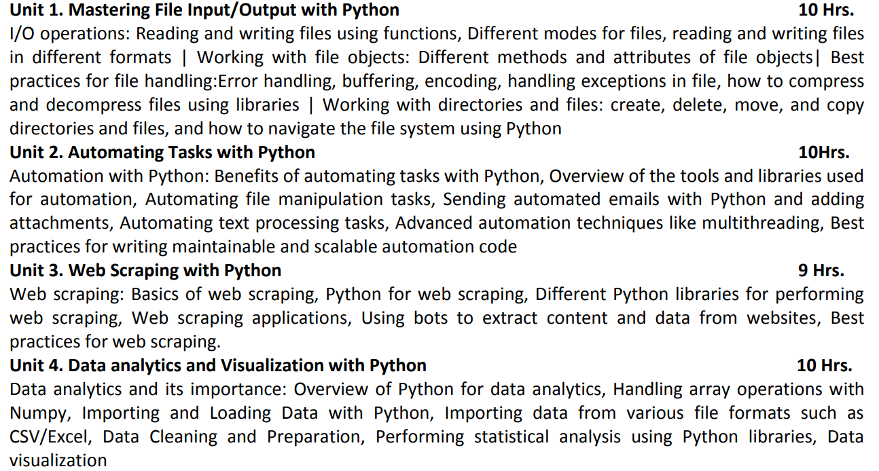

Slide 4
COURSE OUTCOMES
CO 1: Implement Python programs using fundamental programming concepts.
CO 2: Develop skills in file handling and exception handling in Python.
CO 3: Build automated applications.
CO 4: Build web scraping applications and bots.
CO 5: Design Python programs for performing data analysis and data visualization.
CO 6: Develop Python applications for real-world problems.

Slide 5
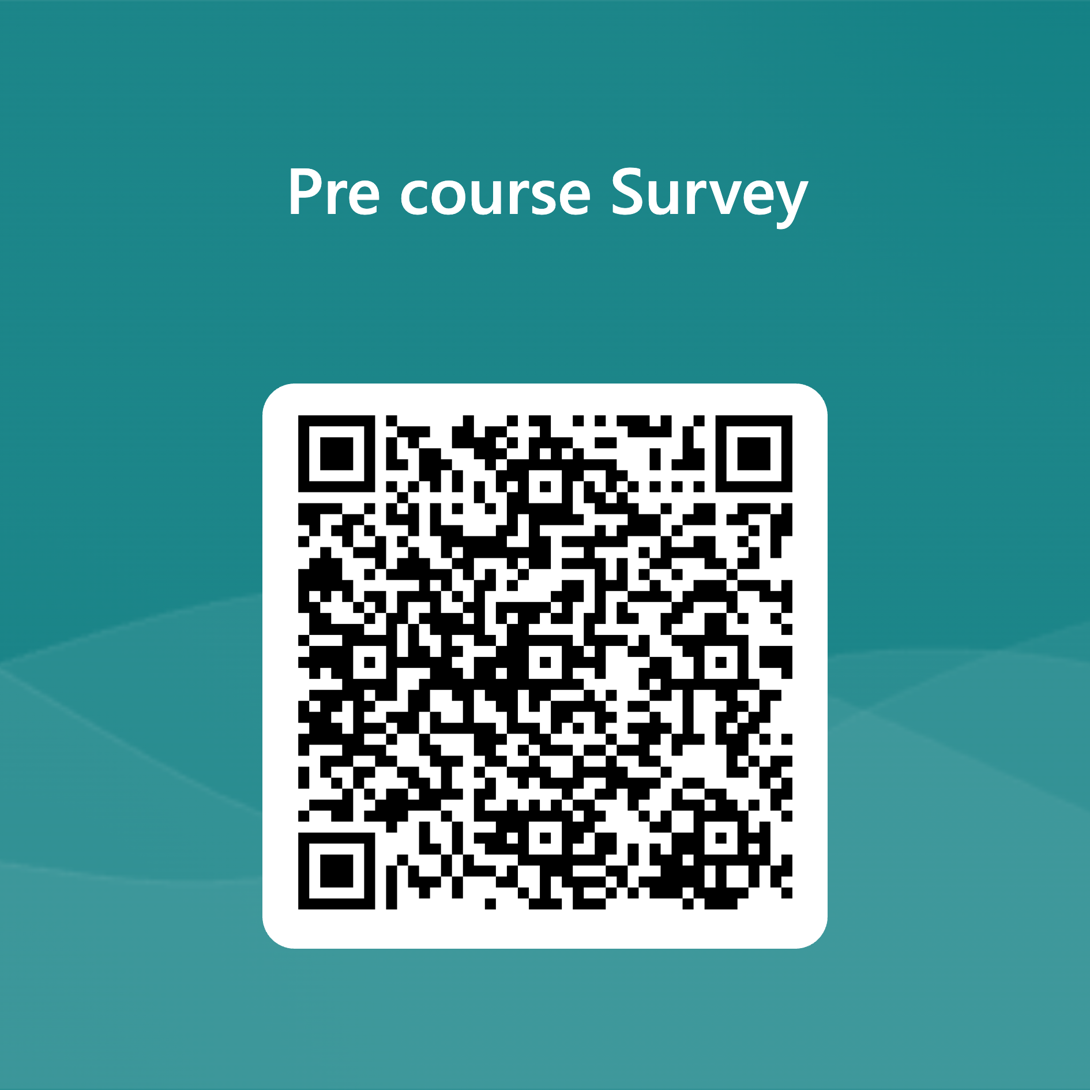

Slide 6


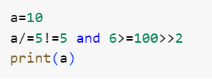
Let’s Recall Basic Python

Slide 7



Slide 8
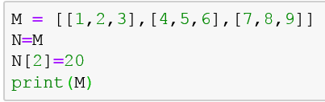
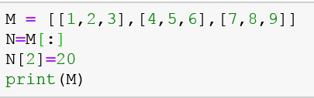

Slide 9
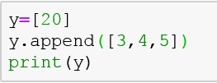
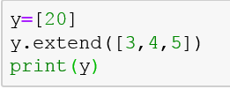

Slide 10
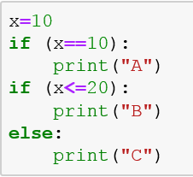
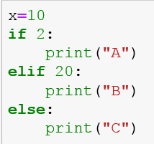
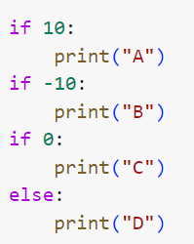
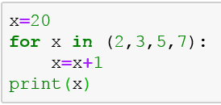

Slide 11
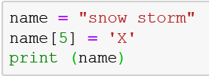
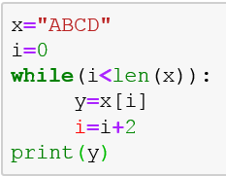
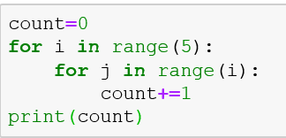

Slide 12
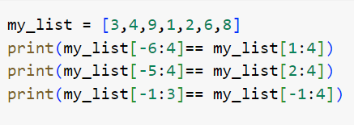
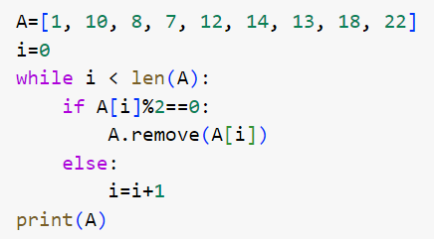

Slide 13


